Slide 1
Lecture 15: Placement – V
Tsung-Wei (TW) Huang
Department of Electrical and Computer Engineering
University of Utah, Salt Lake City, UT

Slide 2
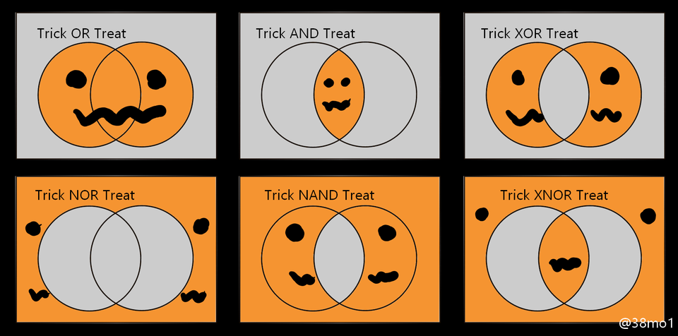
Happy Halloween!

Slide 3
Recap: Quadratic Placement Formulation
(0, 1)
(1,1)
1
0 1 10 0 0
1 0 1 1 1
10 1 0 1 0
0 1 1 0 1
0 1 0 1 0
21 -1 -10 0 0
-1 4 -1 -1 -1
-10 -1 13 -1 0
0 -1 -1 4 -1
0 -1 0 -1 3
3
C =
A =
4
Weight=10
5
2
Weight=10
b_{x} = 0
0
1
1
0.5
b_{y} = 10
0
0
1
0
(1,0)
(0.5,0)
All wire weights = 1 except two highlighted:
gate1 to pad and gate1 to gate2

Slide 4
Recap: Partition-based Placement
Cannot ignore gates outside region we are re-placing
Want gates inside to feel pull from wires to gates outside region
Pseudo-pads do this for us
Pseudo-pads guarantee all gates re-locate inside region
Think of wires as ‘springs’ that each pull gates toward other gates or pads
If pads (real & pseudo) are on edges of region – QP keeps gates inside
Notes:
Why this works?

Slide 5
Recap: Example
a
a
a
1
2
1
placed
1
5
b
5
5
b
b
4
2
4
2
3
4
3
3
c
c
c
1. Initial netlist
5 gates (1,2,3,4,5)
8 wires
3 pads (a,b,c)
2. Initial QP
3. First partition
Sort on X:
Gate order 1 5 4 3 2
Pick: 1 5 4 on left
Notes:
Let’s take a look at an example. (explain …)

Slide 6
Recap: Example (cont’d)
Note: do not propagate pad b, since no wires on left connect to it
placed
a
a
a
1
1
1
5
5
5
b
4
2
2
4
2
4
2
3
3
3
3
c
c
c
4. Propagate gates/pads
Right-side gates: 2,3
Right-side pads: b
Push to cut, using y coordinates
5. 2nd QP input
This is set up for this new smaller placement
6. 2nd QP solved
New placement

Slide 7
Recap: Example (cont’d)
a
placed
a
placed
placed
1
1
1
1
1
5
2
2
2
5
5
5
5
b
b
b
b
2
4
4
4
3
4
3
4
3
3
c
c
c
c
c
7. Left side placed.
Now, re-place right-side gates.
8. Propagate gates/pads
This is set up for next, new smaller placement
9. 3nd QP input
This is set up for this new smaller placement
10. 3nd QP solve

Slide 8
Recap: Example (cont’d)
a
placed
placed
a
a
placed
1
1
1
5
5
b
5
b
b
2
2
4
2,3
2
4
4
4
3
3
3
c
c
c
Repeat: Horizontal
partition on left
Focus on top. Sort gates on Y
Assign gates 1,5 to region.
Propagate gates & pads

Slide 9
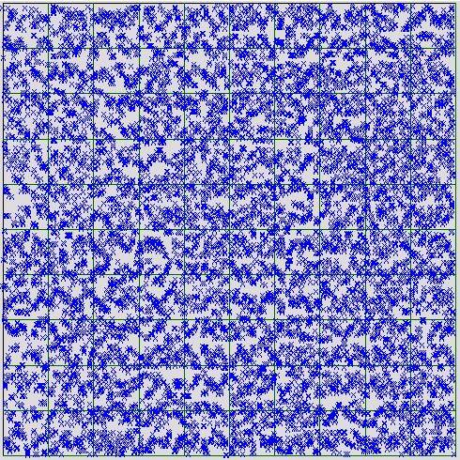
Recap: Keep Repeating this Recursion
Keep recursively partitioning…
Usually, you continue until you have a “small” number of gates in each region
Small >> 1 typically. 10-100 for example
Get a good, “global” placement, but not a “final” placement
a
placed
placed
1
2
5
b
4
3
placed
placed
c
Continue…
Notes:
(ask students Pros and Cons)

Slide 10
Recap: Legalization
Still need to force gates in precise rows for final result
QP methods cannot force individual gates into standard cell rows, without overlaps
Solution step is called: Legalization
Many different algorithms. One easy way to do this is by annealing!
Do local improvement based on swaps of nearby gates
To anneal, set T=HOT to be very small (cold), so don’t disrupt QP result
Notes:
Final placement needs to be a valid solution. What we did was to decide rough locations of cells while satisfying balance constraint, which is also called global placement. So, the solution from global placement still has overlaps unless you really do the partition to the very fine-grained level like each partition can have only one cell then you don’t have the overlap problem.
To remove all these overlaps, there is another stage of algorithm called legalization. The goal of legalization is to find the exact locations of gates such that no overlaps will happen, like this example, no overlap.
And there are many different algorithm for legalization, and it is very similar to the game, Tetris, you play when you were little. As you can already imagine, one easy way to do this is by annealing. (explain …)

Slide 11
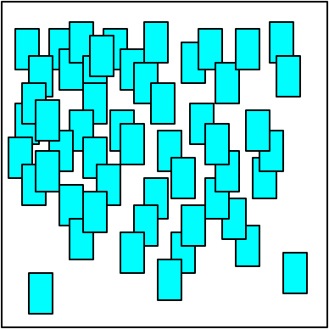
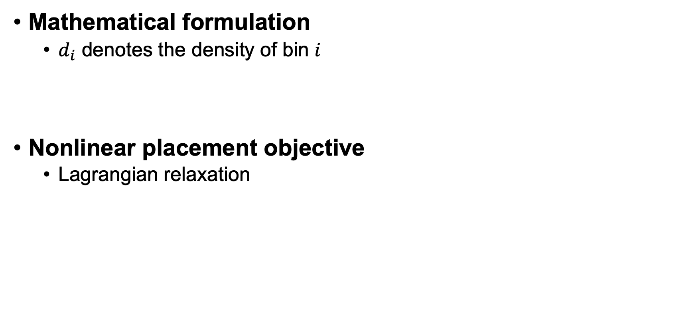
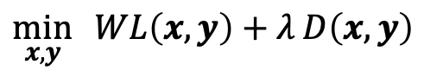
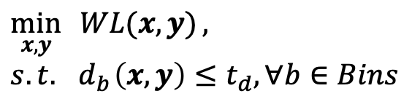
Nonlinear Placement
Mathematical formulation
$d_{i}$ denotes the density of bin $i$
Nonlinear placement objective
Lagrangian relaxation
$$\min_{x,y}{ WL(x, y)},$$
$$s.t. { d}_{b}\left(x, y\right)≤t_{d}, ∀b∈Bins$$
$$\min_{x,y}{ WL\left(x, y\right)+λ}D\left(x,y\right)$$
Wirelength
Density
Bins
Notes:
Now, we have talked about quadratic placement. It’s sort of a linear way to optimize cell locations because when you take the gradient on the optimization function, you get a bunch of linear equations to solve. The solution gives you the cell location.
Simple, but it has a drawback, right. It does not consider cell overlap and in many cases the minimum wirelength will lump all cell together to have a large number of overlaps. To solve it, we introduce the partition-based method with pseudo-pad propagation to pull cells out of each other. All the effort we did was to spread out cells so we don’t have a very dense area.
Now think about this, why don’t we just model this density constraint in our formulation? In addition to minimizing the wirelength, can’t we just model the density constraint in the formulation and ask the solution to satisfy density constraints. For example (explain…)

Slide 12
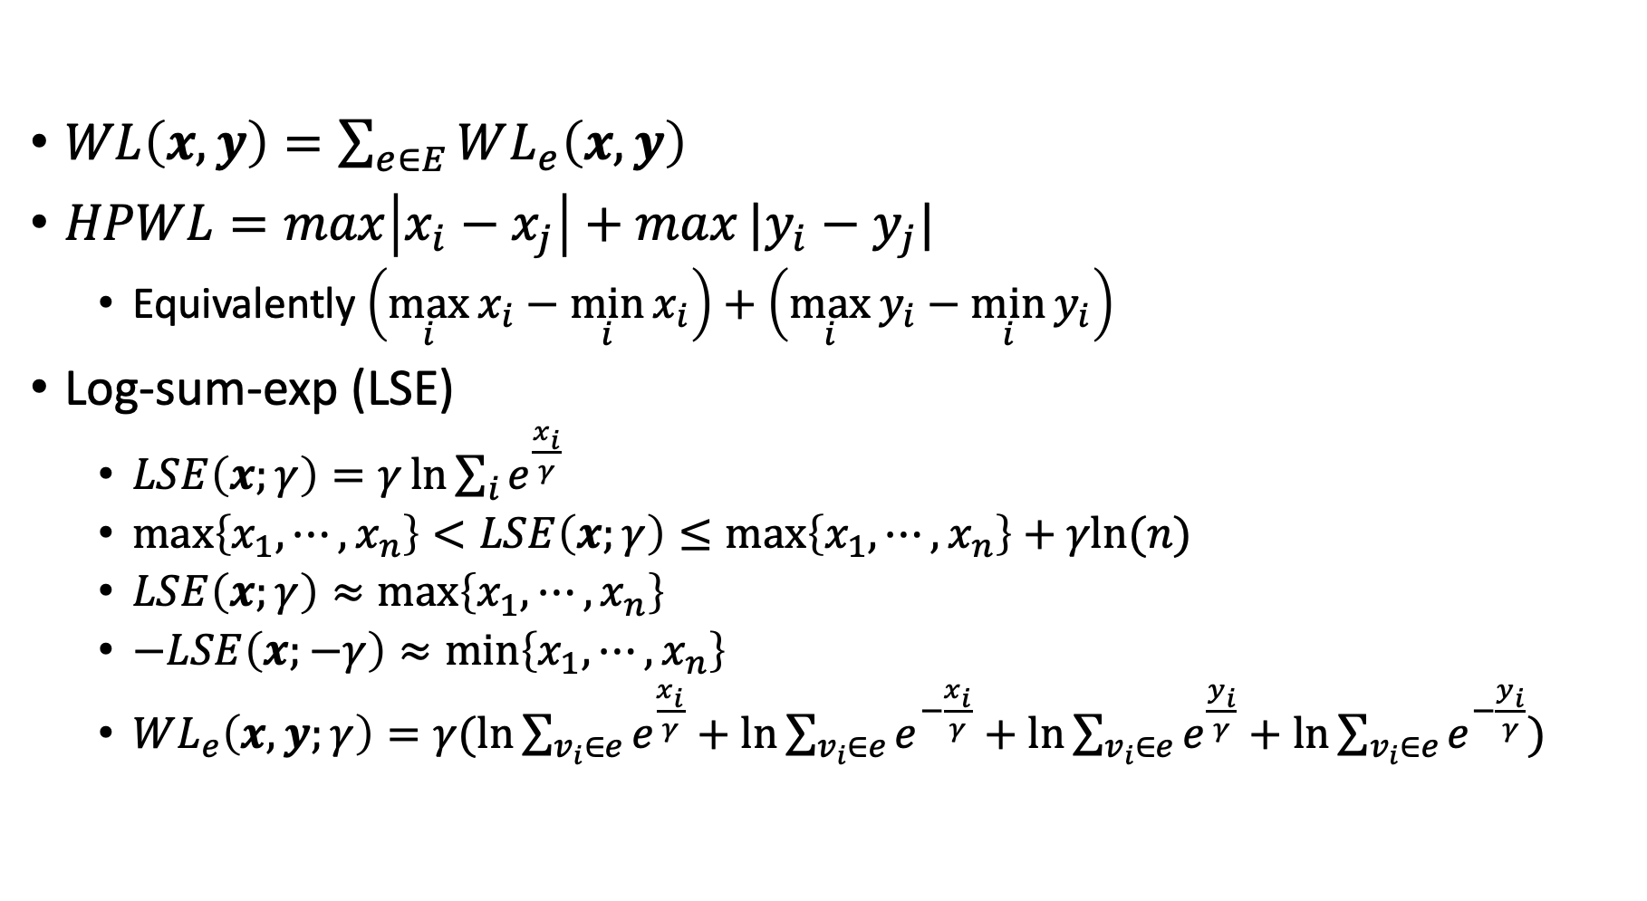
Wirelength Smoothing
$WL\left(x, y\right)=\sum_{e∈E}{WL_{e}\left(x, y\right)}$
$HPWL=\max\left|x_{i}−x_{j}\right|+max|y_{i}−y_{j}|$
Equivalently $\left(\max_{i}{x_{i}}−\min_{i}{x_{i}}\right)+\left(\max_{i}{y_{i}}−\min_{i}{y_{i}}\right)$
Log-sum-exp (LSE)
$LSE\left(x;γ\right)=γ\ln{\sum_{i}{e^{\frac{x_{i}}{γ}}}}$
$\max\left\{x_{1},⋯,x_{n}\right\}<LSE\left(x;γ\right)≤\max\left\{x_{1},⋯,x_{n}\right\}+γln{(n)}$
$LSE\left(x;γ\right)≈\max\left\{x_{1},⋯,x_{n}\right\}$
$−LSE\left(x;−γ\right)≈\min\left\{x_{1},⋯,x_{n}\right\}$
$WL_{e}\left(x, y;γ\right)=γ(\ln{\sum_{v_{i}∈e}{e^{\frac{x_{i}}{γ}}}}+\ln{\sum_{v_{i}∈e}{e^{−\frac{x_{i}}{γ}}}}+\ln{\sum_{v_{i}∈e}{e^{\frac{y_{i}}{γ}}}}+\ln{\sum_{v_{i}∈e}{e^{−\frac{y_{i}}{γ}}}})$
x
y
Notes:
Furthermore, can we optimize the HPWL directly instead of making it quadratic? We know HPWL is the half parameter wirelength of the minimum bounding box that encloses a net, and it can be described as the maximum x-distance plus the maximum y-distance. Why can’t we put it into the objective? (ask student)
So, to make it differentiable, we need a smooth function that can represent or approximate HPWL. That gives us the log-sum-exp or LSE function to approximate the HPWL. The function is as follows: here, we have a gamma as a tunable parameter to adjust how close the LSE you want to approximate the HPWL. (explain …)
And, (click) it turns out the term LSE(x, r) is very close to the maximum of x, and the term (click and explain…)
So, the HPWL can be approximated in the following equation (explain …)

Slide 13
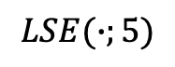
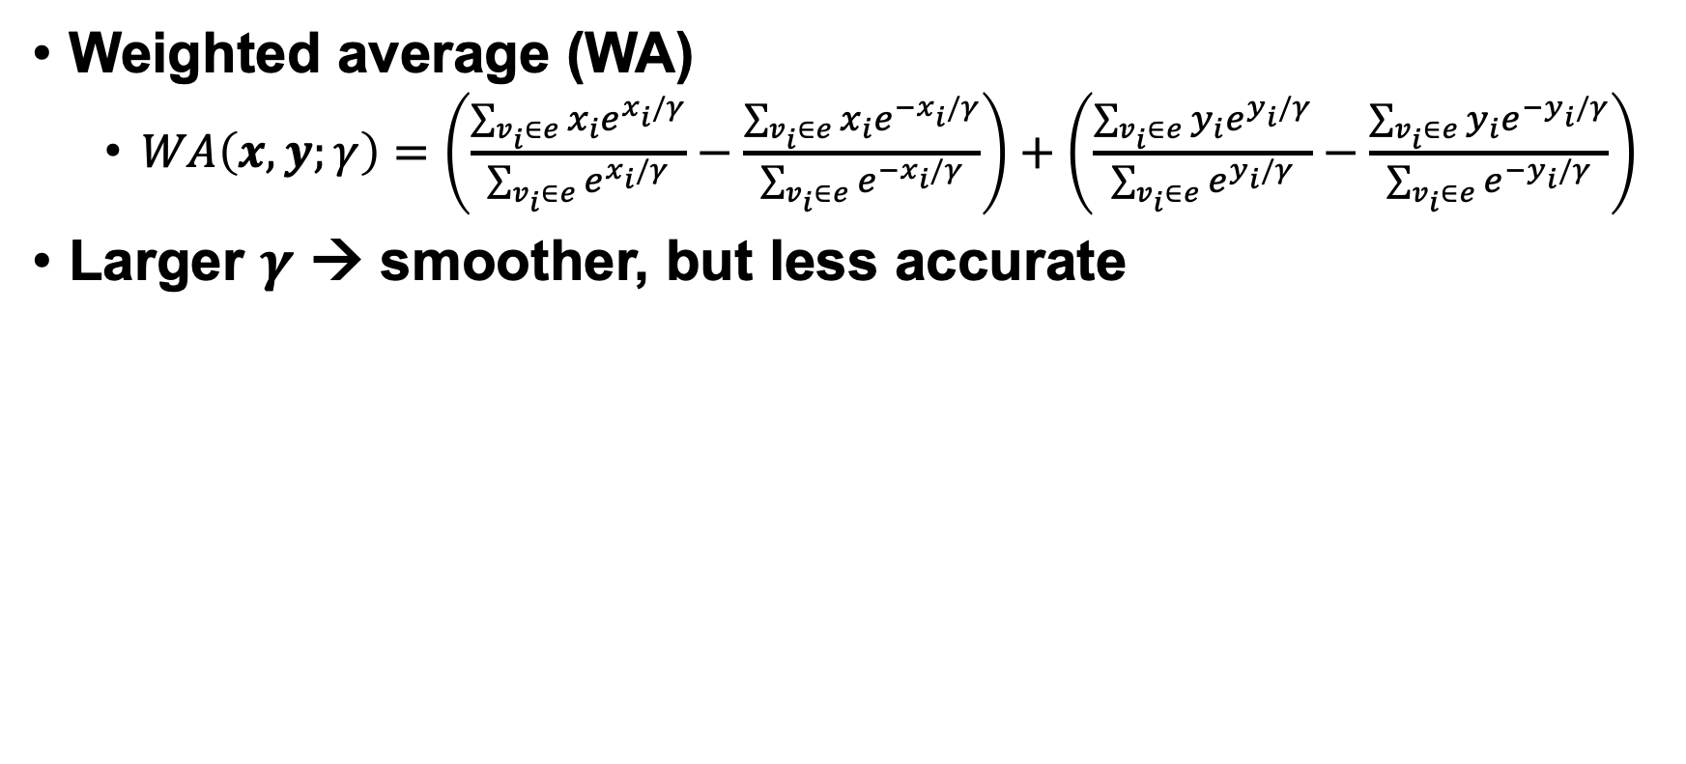
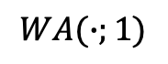
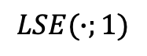
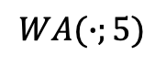
Wirelength Smoothing (cont’d)
Weighted average (WA)
$WA\left(x, y;γ\right)=\left(\frac{\sum_{v_{i}∈e}{x_{i}e^{x_{i}/γ}}}{\sum_{v_{i}∈e}{e^{x_{i}/γ}}}−\frac{\sum_{v_{i}∈e}{x_{i}e^{−x_{i}/γ}}}{\sum_{v_{i}∈e}{e^{−x_{i}/γ}}}\right)+\left(\frac{\sum_{v_{i}∈e}{y_{i}e^{y_{i}/γ}}}{\sum_{v_{i}∈e}{e^{y_{i}/γ}}}−\frac{\sum_{v_{i}∈e}{y_{i}e^{−y_{i}/γ}}}{\sum_{v_{i}∈e}{e^{−y_{i}/γ}}}\right)$
Larger $γ$ → smoother, but less accurate
Net: (x, 0) (0, 0)
$$LSE(∙;5)$$
$$LSE(∙;1)$$
HPWL
HPWL
$$WA(∙;1)$$
$$WA(∙;5)$$
Notes:
Because this is an exponential function, small value can become very small and large value will become very large. To avoid much bias on large or small value, we often take a weighted average on the summation value to kind of normalize different x and y to a central value around 0 and 1. We can do this by multiplying each exponential term with its x or y value and then divide the summation by the one that doesn’t not have the multiplication. Similarly, we can do this for y.
So, how does this look? (explain …)

Slide 14
Nonlinear Placement
Chen, Tung-Chieh, et al. "NTUplace: A ratio partitioning based placement algorithm for large-scale mixed-size designs." ISPD 2005
Chen, Tung-Chieh, et al. "NTUplace3: An analytical placer for large-scale mixed-size designs with preplaced blocks and density constraints." IEEE TCAD 2008.
Hsu, Meng-Kai, et al. "NTUplace4h: A novel routability-driven placement algorithm for hierarchical mixed-size circuit designs." IEEE TCAD 2014
Huang, Chau-Chin, et al. "NTUplace4dr: a detailed-routing-driven placer for mixed-size circuit designs with technology and region constraints." IEEE TCAD 2017
Notes:
Based on this idea, there has been many research progress on nonlinear placement algorithms. You know, the team from National Taiwan University has been a strong advocate for this kind of approach. The author Dr. Chen has proposed many placement algorithm, called NTU place in several places, and you can check it out to understand more details if you want.

Slide 15
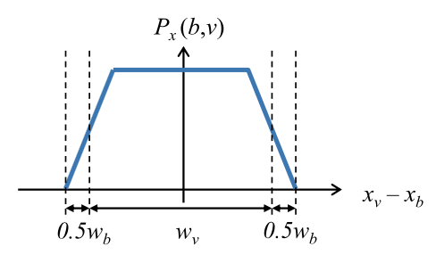
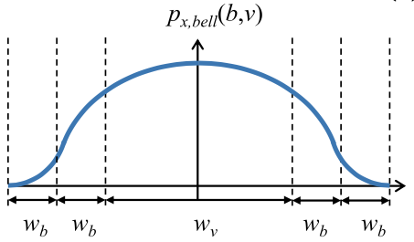
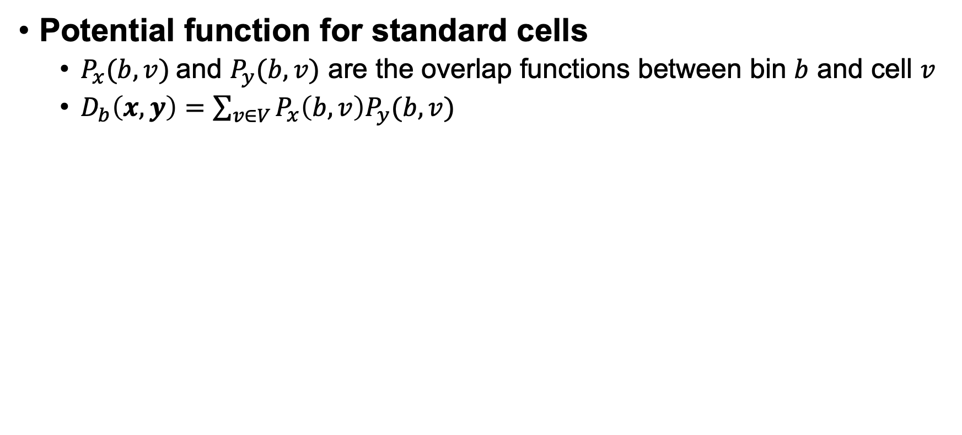
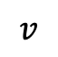
Density Penalty
Potential function for standard cells
$P_{x}(b,v)$ and $P_{y}(b,v)$ are the overlap functions between bin $b$ and cell $v$
$D_{b}\left(x,y\right)=\sum_{v∈V}{P_{x}\left(b, v\right)P_{y}(b,v)}$
$$v$$
Non-smooth
Non-convex
Bell-shape smoothing
Notes:
But we havn’t talked about how to model the density constraint, right? We just talked about how to approximate the wirelength HPWL using LSE equations, but we didn’t explain how density constraint can be model. A common way to model the overlap between a partitioned bin b and a cell v is potential function. So we define Px(b, v) to be the density in terms of overlapped area between a bin b and a cell v. Visualizing the function over the distance difference between xv and xb, we have the following figure. On the very left side, I don’t have any overlap, and when I keep moving the cell from left to the middle of the bin, we have a lot of overlap and the maximum is a constant, the cell area, … (explain...)
But, again, this function is not smooth. We cannot differentiate it. So one technique is to use bell function to approximate it.
And, we can multiply the density function x with the density function y together to be our total density function.

Slide 16
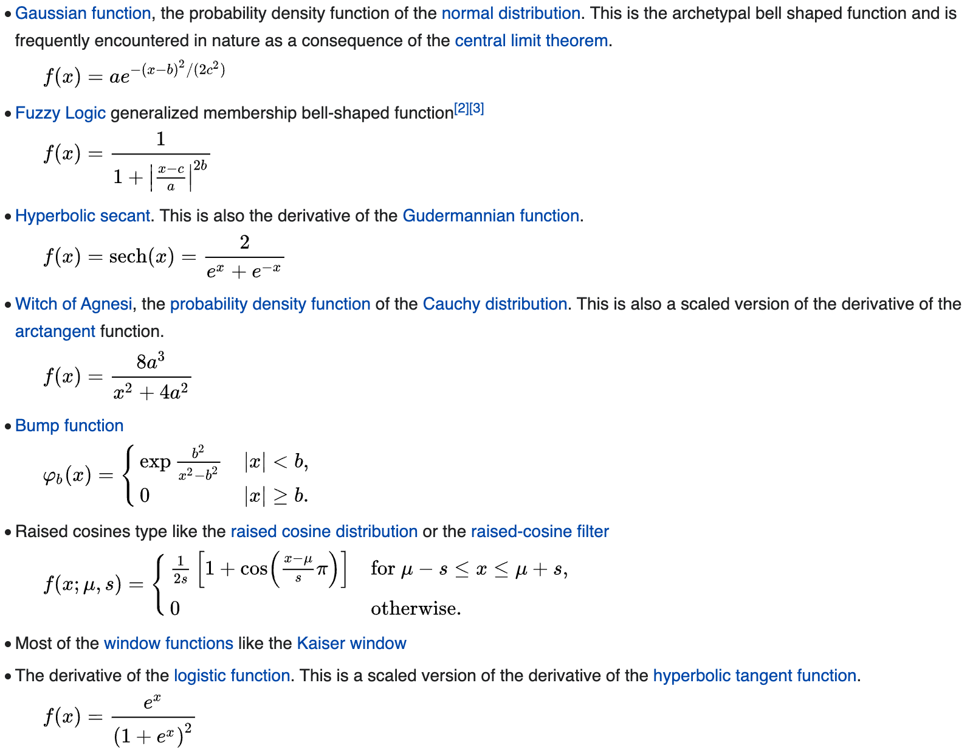
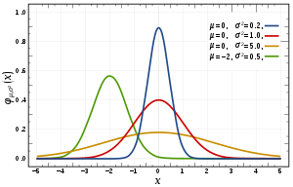
Bell Function Examples
Notes:
There is no single bell function universally good for everything. In fact, the simplest bell function is the gaussian function, you know, the probability density function of the normal distribution. (explain …)

Slide 17
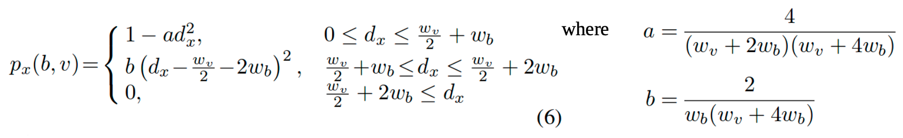
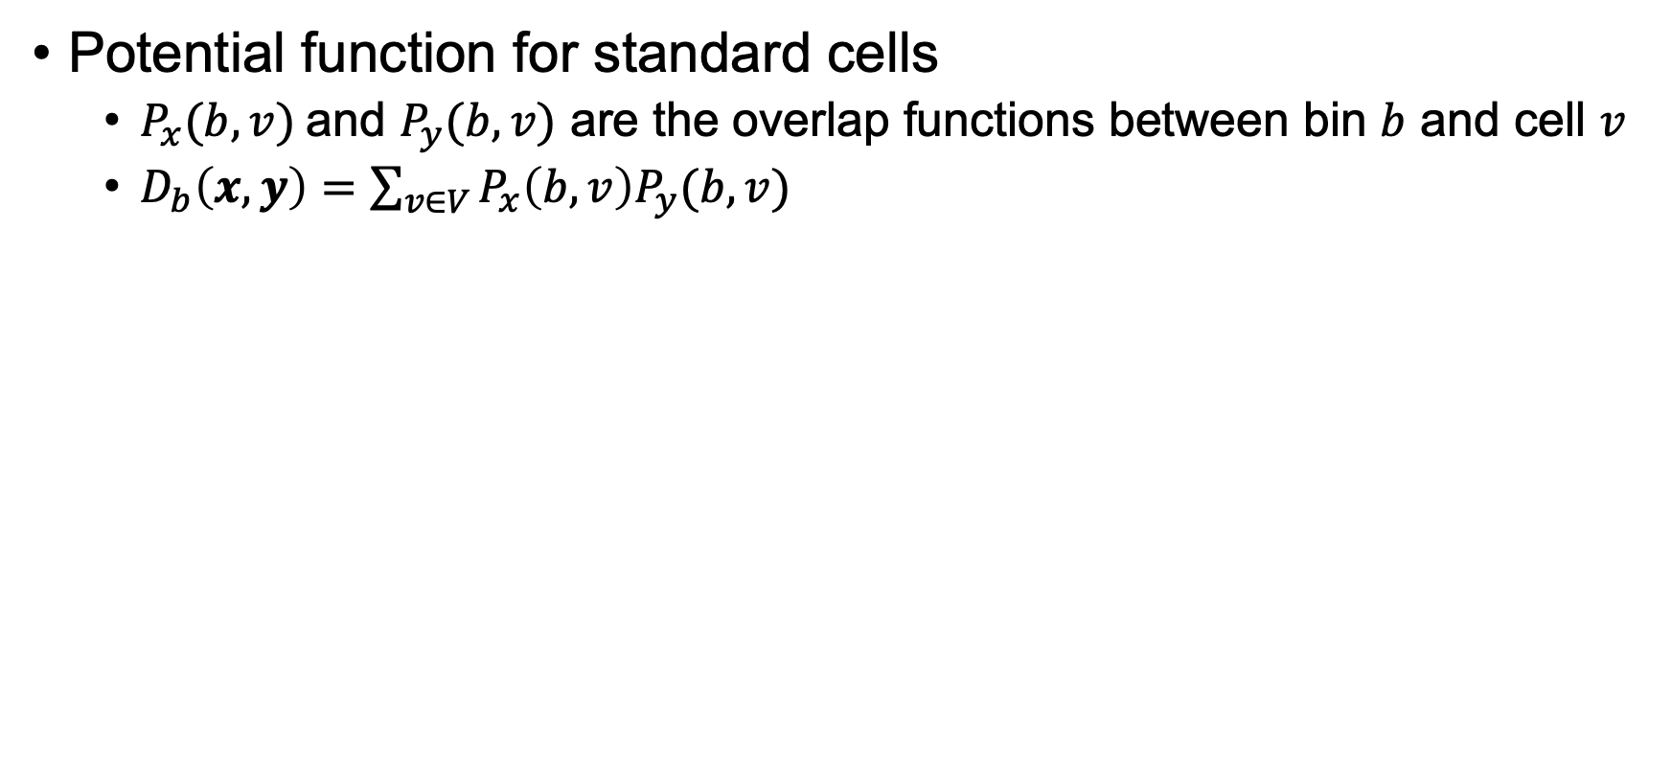
Density Penalty (cont’d)
Potential function for standard cells
$P_{x}(b,v)$ and $P_{y}(b,v)$ are the overlap functions between bin $b$ and cell $v$
$D_{b}\left(x,y\right)=\sum_{v∈V}{P_{x}\left(b, v\right)P_{y}(b,v)}$
Bell-shape smoothing
Variables dx (dy) is the absolute center-to-center distance between cell v and bin b in the x (y) direction
Notes:
Now we know we can use bell function to approximate the overlap function, the potential function for a standard cell, to describe a differentiable form of how it overlaps with a bin. We can write down the density constraint as follows: first we have dx, to represent center-to-center distance between cell v and bin v in the x direction, similarly for dy. We know we can separate dx and dy because when we take differentiation, x and y are separate from each other. Then, we can say, if you fall in this region, the your potential function is defined as follows (explain other part).
Keep in mind, this is just a heuristic function to approximate the overlap function. You can define your own bell function as long as it is differentiable, but this is a very famous way of bell approximation and has been used in industrial tools.

Slide 18
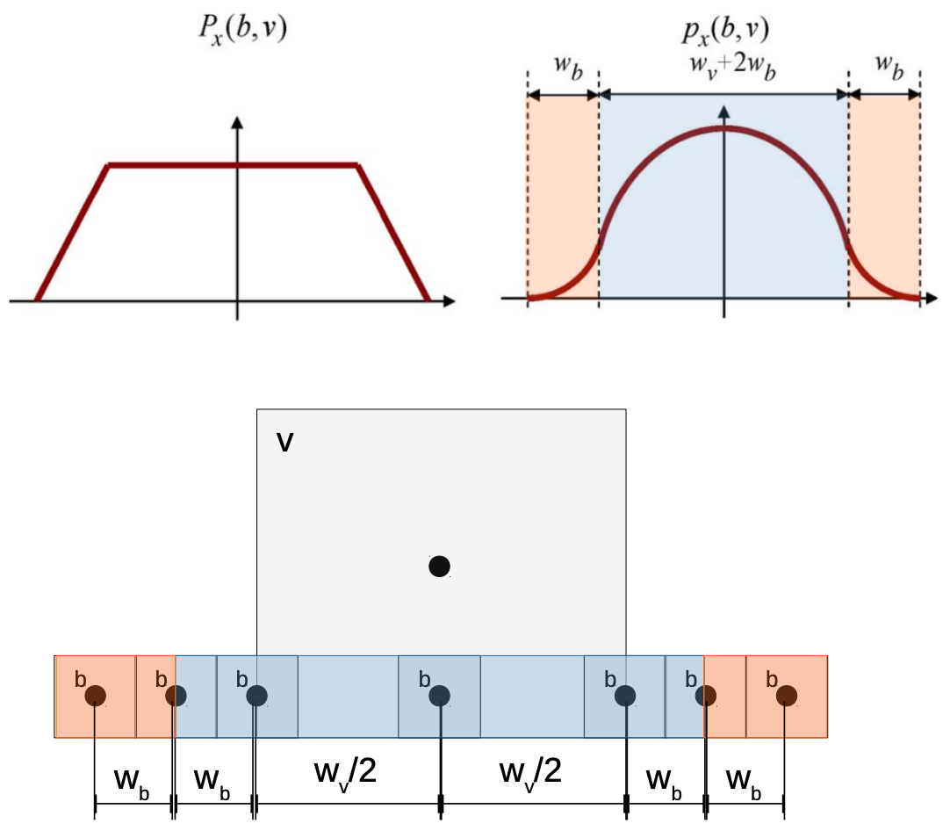
Visualization
Notes:
Now, let’s visualize the function. The x axis here is the center-to-center distance between cell and the bin, and it is an absolute value. Which part of the function px belongs to the blue area? (ask student)

Slide 19
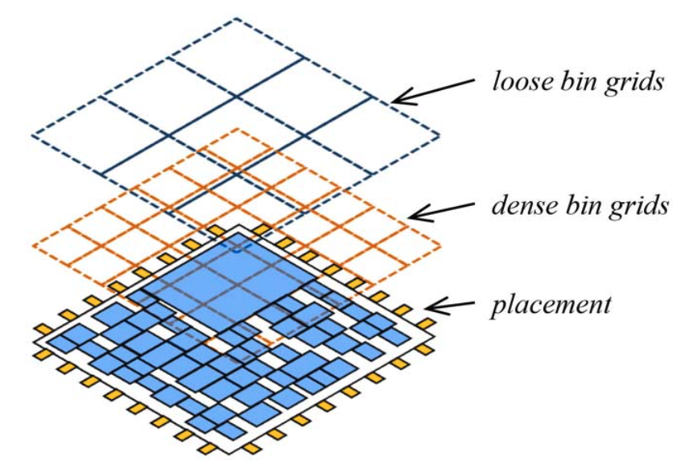
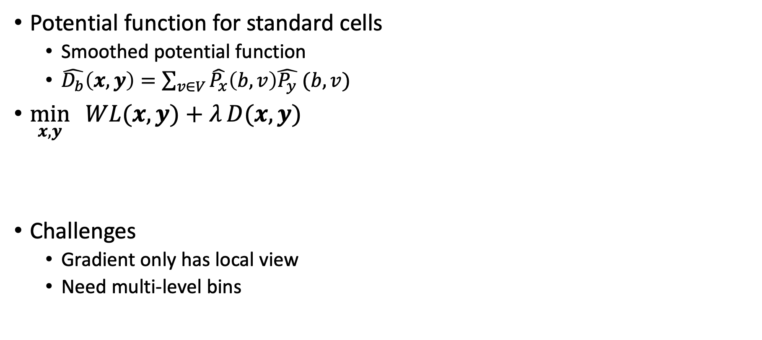
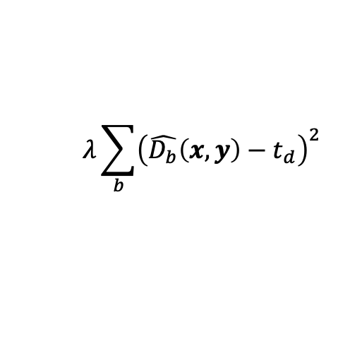
Density Penalty (cont’d)
Potential function for standard cells
Smoothed potential function
$\hat{D_{b}}\left(x,y\right)=\sum_{v∈V}{\hat{P_{x}}\left(b, v\right)\hat{P_{y}} (b,v)}$
$\min_{x,y}{ WL(x, y)+λ}D(x,y)$
Challenges
Gradient only has local view
Need multi-level bins
$$λ\sum_{b}{{\left(\hat{D_{b}}\left(x,y\right)−t_{d}\right)}^{2}}$$
Multi-level bins
Notes:
Now we can formally define our mathematical function to optimize in a nonlinear form:

Slide 20
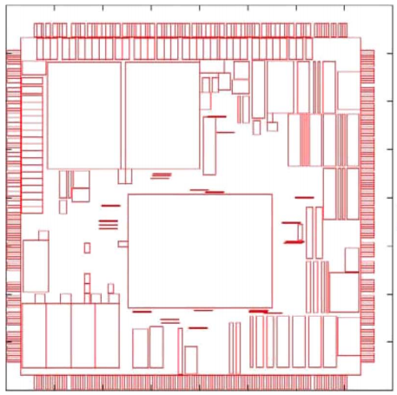
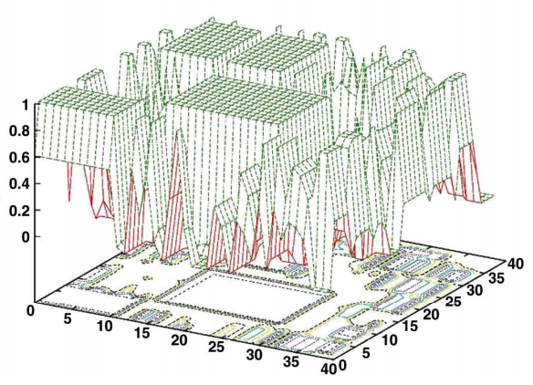
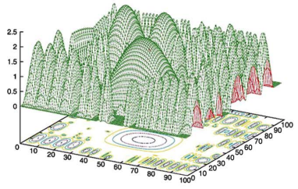
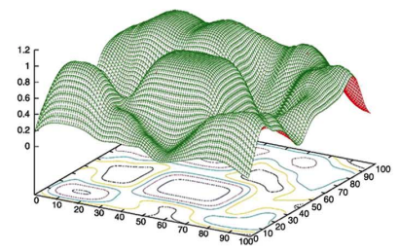
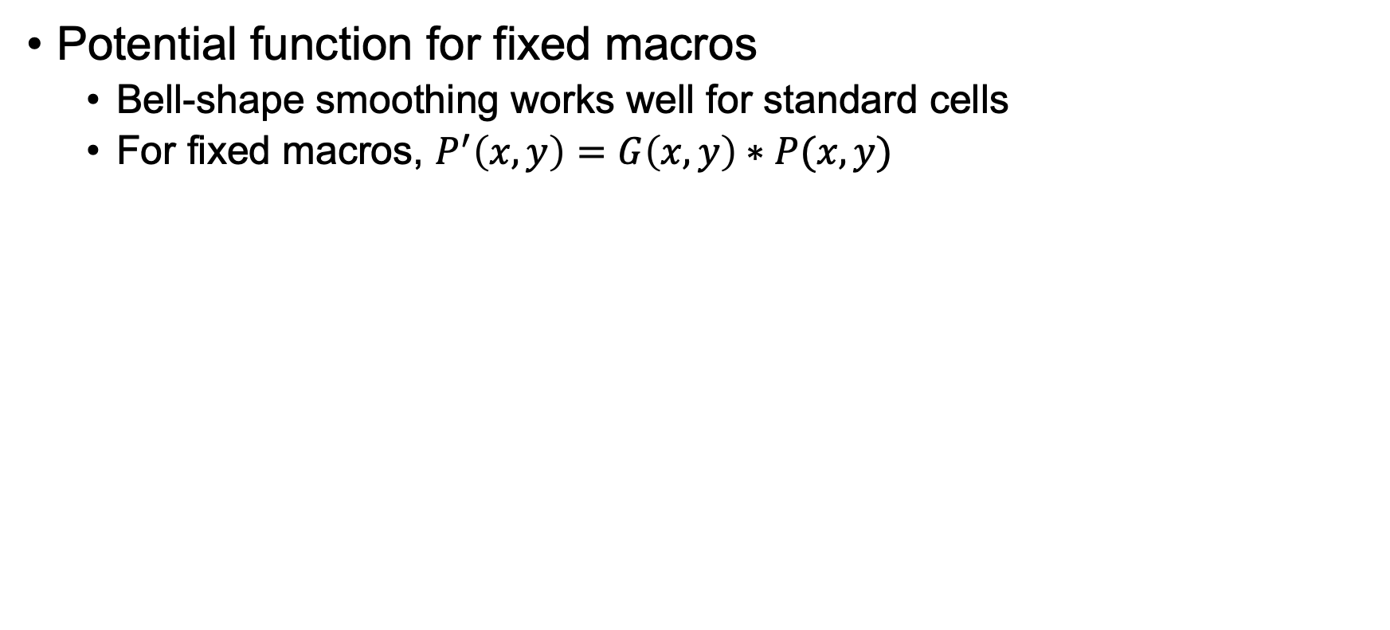
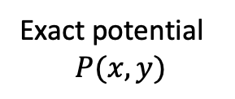
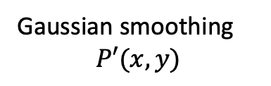
Density with Fixed Macro
Potential function for fixed macros
Bell-shape smoothing works well for standard cells
For fixed macros, $P^{′}\left(x,y\right)=G\left(x,y\right)∗P(x,y)$
ISPD2005
adaptec2
Exact potential
$$P(x,y)$$
Gaussian smoothing
$$P′(x,y)$$
Bell-shape smoothing
Notes:
What about the potential function for fixed macros? You know, fixed macro cannot be moved, so no matter how you approximate it, the value is always the same. (explain …)

Slide 21
Nonlinear Placer – ePlace
Lu, Jingwei, et al. "ePlace: Electrostatics-based placement using fast fourier transform and Nesterov's method." ACM TODAES 2015.
Cheng, Chung-Kuan, et al. "RePlAce: Advancing solution quality and routability validation in global placement." IEEE TCAD 2018.
Lin, Yibo, et al. "DREAMPlace: Deep learning toolkit-enabled gpu acceleration for modern vlsi placement." IEEE TCAD 2020. (DAC 2019 Best Paper Award)
Notes:
That was the density function proposed by NTU placer, the team from National Taiwan University. We also have quite a few new approaches to handle the density constraint. One of the very famous method is the ePlace, which approximates the density using electronstatics, and there are many other papers following to speed up the core algorithm such as the DREAMPlace.

Slide 22
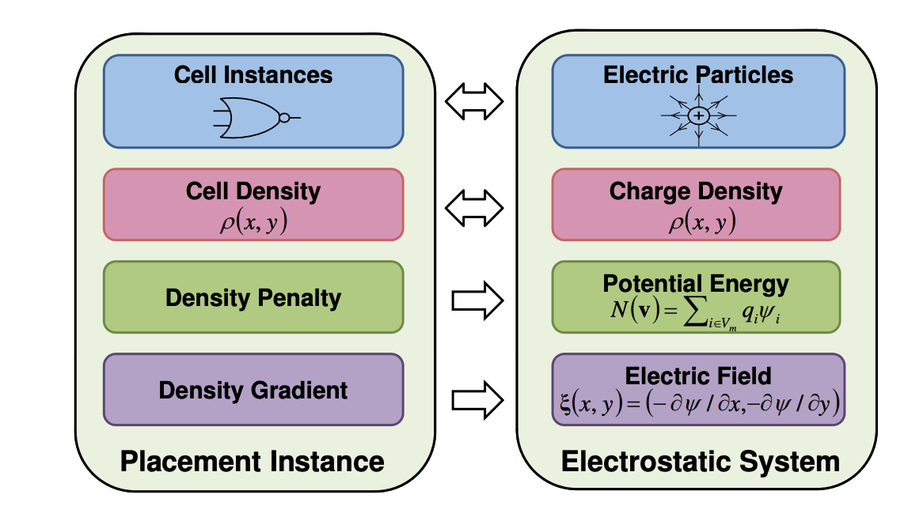
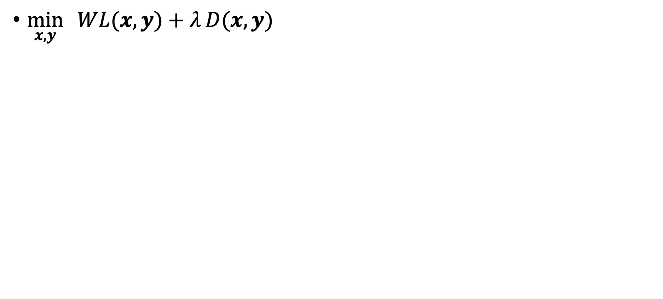
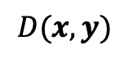
ePlace: Electric Potential
$\min_{x,y}{ WL(x, y)+λ}D(x,y)$
Exact density
$$D(x,y)$$
Notes:
What does this electrostatics-based method, eplace, do? IT views the entire placement problem as a system of electric particles that try to drag and push each other depending on your charge density. And if you are too close to or too far from each other, the potential energy induced by such placement will incur some penalty. Then, based on this idea, we model the system into an energy optimization problem and take gradient to seek the best locations of particles.

Slide 23
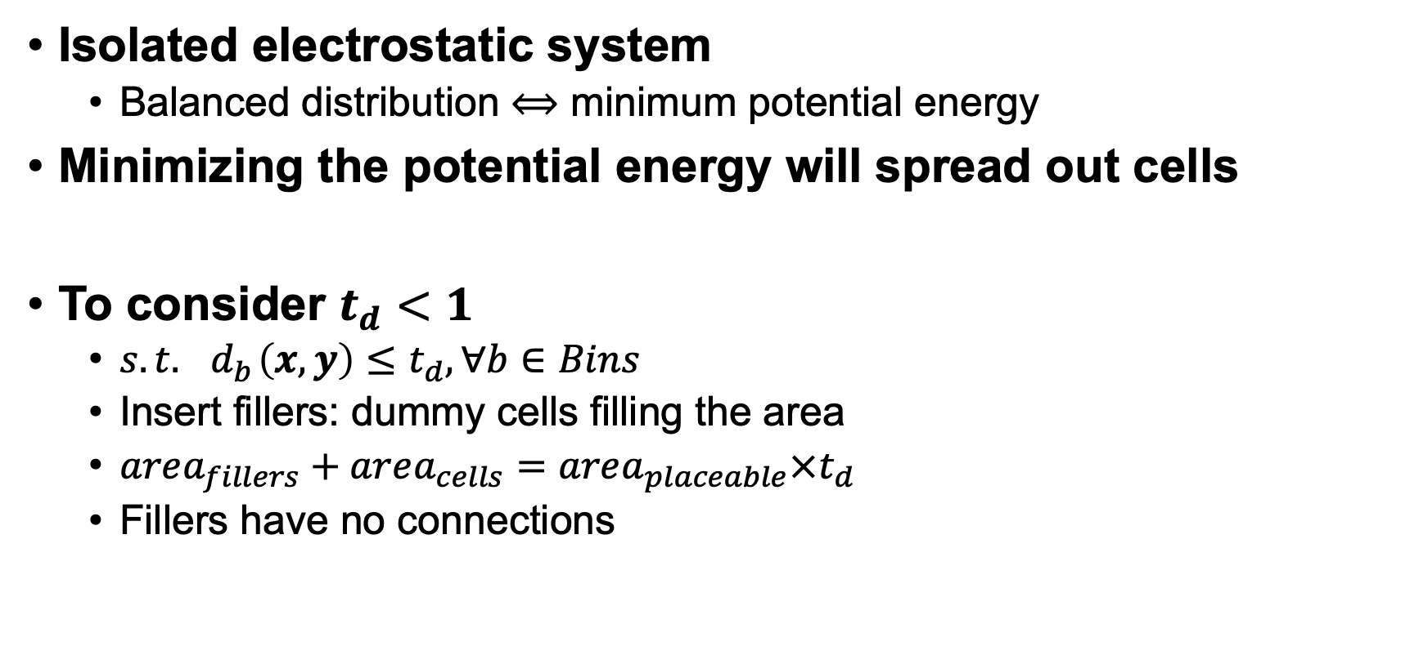
Electrostatic System: Physics Effects
Isolated electrostatic system
Balanced distribution $⟺$ minimum potential energy
Minimizing the potential energy will spread out cells
To consider $t_{d}<1$
$s.t.{ d}_{b}\left(x, y\right)≤t_{d}, ∀b∈Bins$
Insert fillers: dummy cells filling the area
$area_{fillers}+area_{cells}=area_{placeable}×t_{d}$
Fillers have no connections
Notes:
Of course, the idea is based on a few assumptions that do not violate physics law. For example …

Slide 24
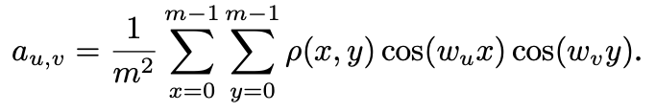
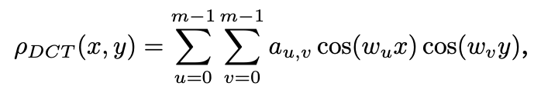
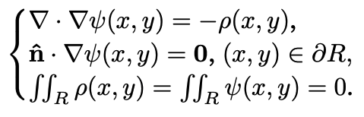
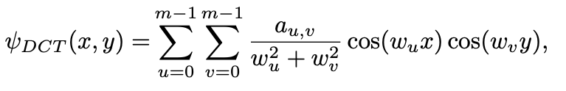
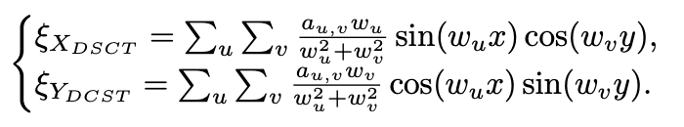
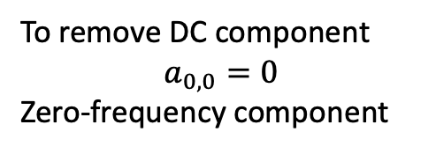
Poisson’s Equation for Electrostatic System
Solution
Total charge
Total energy
To remove DC component
$$a_{0,0}=0$$
Zero-frequency component
In forms of DCT and DST
Notes:
Also, we need to describe how electric particles move. And the authors use the poisson’s equation to describe how each particle moves in a probabilistic form. Under this idea, the total charge should be equal to the total energy the system can consume. (explain…)
Of course, this is just an overview, and I am not going to go through many details, but essentially, the idea is to model each cell as an electric particle and constraint the movement on minimizing the total energy the system has. You can find more details in their papers.

Slide 25
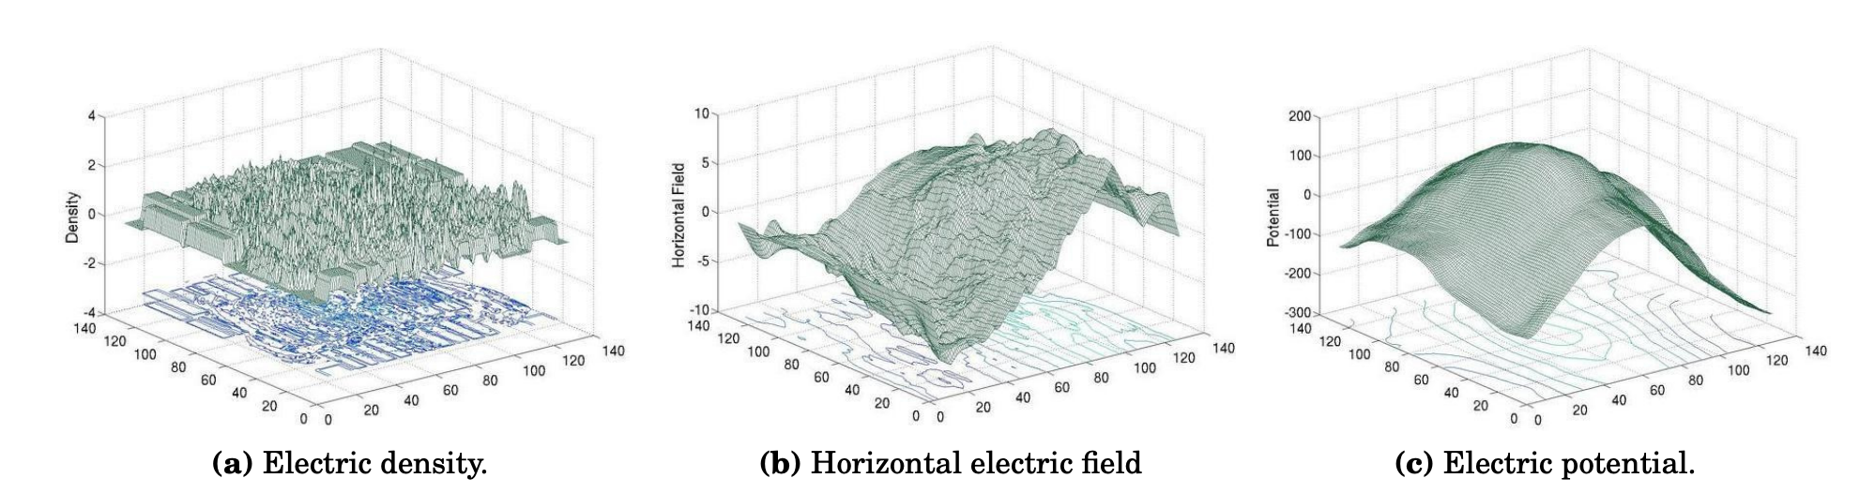
Electrical Potential
Notes:
This slide visualizes the electrical potential. On the left, you can see a map of electric density (explain …)

Slide 26
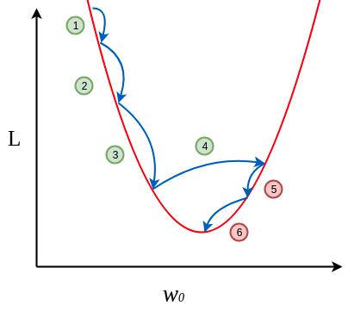
Gradient Solver
Conjugate gradient (CG) descent
Between steepest descent & Newton method
Avoid computation of Hessian
Nesterov’s accelerated gradient descent

Slide 27
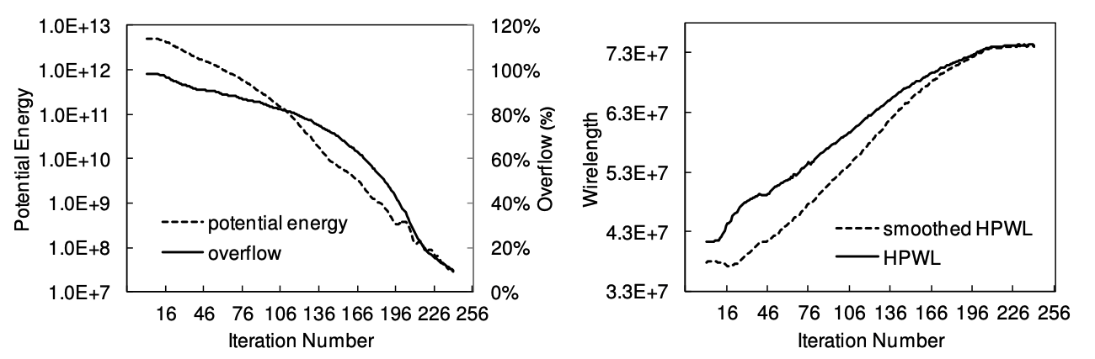
Gradient Descent Iterations

Slide 28
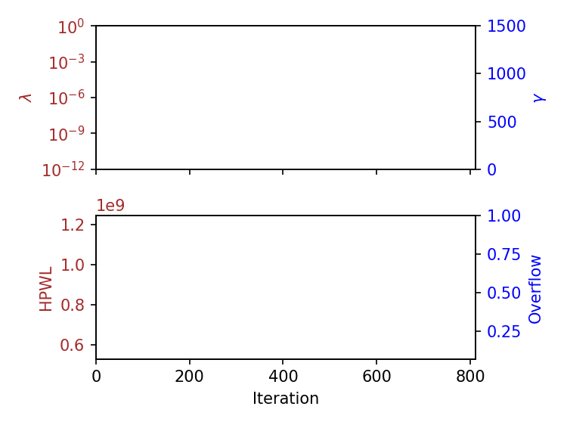
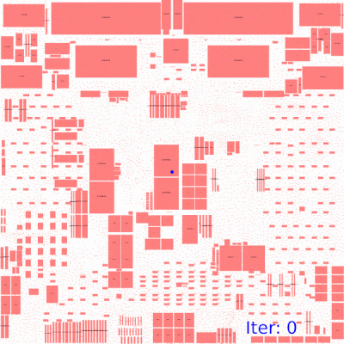
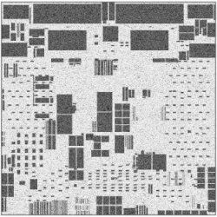
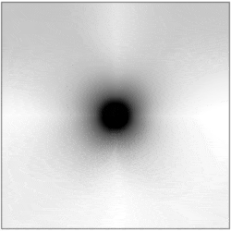
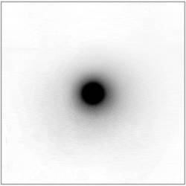
Industrial Example
Placement Metrics
Density Map
Potential Map
Field Map

Slide 29
Summary
We have discussed nonlinear placement
Wirelength smoothing: LSE and WA
Density potential (NTUplace)
Electric potential (ePlace)
Open-source tools
DREAMPlace: https://github.com/limbo018/DREAMPlace
RePlAce: https://github.com/The-OpenROAD-Project/RePlAce

Slide 30
In-class Presentation: 11/16
Placement research presentation on 11/16 (in class)
Yibo Lin, Shounak Dhar, Wuxi Li, Haoxing Ren, Brucek Khailany and David Z. Pan, "DREAMPlace: Deep Learning Toolkit-Enabled GPU Acceleration for Modern VLSI Placement", ACM/IEEE Design Automation Conference (DAC), Las Vegas, NV, Jun 2-6, 2019
Spindler, Peter and Schlichtmann, Ulf and Johannes, Frank M., "Abacus: fast legalization of standard cell circuits with minimal movement," ACM Proceedings of the 2008 International Symposium on Physical Design (ISPD), pp. 47–53, 2008
Upload your pptx to https://github.com/tsung-wei-huang/ece5960-physical-design/issues/12 before presentation

